Slide 1
Philip G. Vroom Community School
Home of the Dragons
Our School motto since 1914:
Vroom School: Where we study not for school, but for life
Our School’s theme for 2022-2023:
"Show Your True COLORS"
Mrs. Stacey Janeczko, Principal
Ms. Allison Conway, Nurse
Mrs. Sandra D’Angelo, Guidance
Mr. Wayne Gill, Administrative Assistant

Slide 2
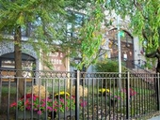
Welcome Back Students, Staff, and Parents!
Doors open for students at 8:25 am
PreK - Enter Door #2
K - Enter Door #7
Grades 1-3 - Enter Door #6
Grades 4-8 - Enter Front Door
Attendance is taken for students at 8:50am
Fire Drills are conducted twice a month.
School Safety Drills (Lockdown, etc)
are conducted once a month.

Slide 3
Dismissal
Pre-K & K 2:45pm Gr. 1-3 2:50 Gr. 4-8 2:55
Gr. Pre-K Door # 2 (Broadway side)
Gr. K Door # 7 (Driveway/Avenue C side)
Gr. 1 Door # 3 (Back schoolyard towards Broadway side)
Gr. 2 Door # 3 (Back schoolyard towards Broadway side)
Gr. 3 Door # 6 (Schoolyard towards Broadway side)
Gr. 4 Door # 7 (Driveway/Avenue C side)
Gr. 5 Door # 7 (Driveway/Avenue C side)
Gr. 6 Ramp Door - front of building
Gr. 7 Door # 2 (Broadway Side)
Gr. 8 Door # 2 (Broadway Side)

Slide 4
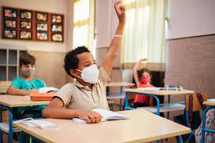
Student Code of Conduct
The 2022-2023 Student Code of Conduct is posted on the Vroom School website - Direct link:
https://docs.google.com/document/d/19HsEwTohguFqna8-UDTOYwkD37pepPSf_2O9f1keA6U/edit?usp=sharing
Please review the Code of Conduct with your child.

Slide 5
Monitoring Student Progress
Parent Portal login- please contact sdangelo@bboed.org if you need assistance
Parent Portal:
https://www.fridayparentportal.com/bayonne
For assistance, please email portalhelp@bboed.org.
District Mobile App:
https://www.bboed.org/domain/293
For assistance, please email blackboardhelp@bboed.org.
Learning Platforms:
SeeSaw - Pre Kindergarten, K and 1
Schoology - 2-8
Communicate directly with your child’s teacher

Slide 6
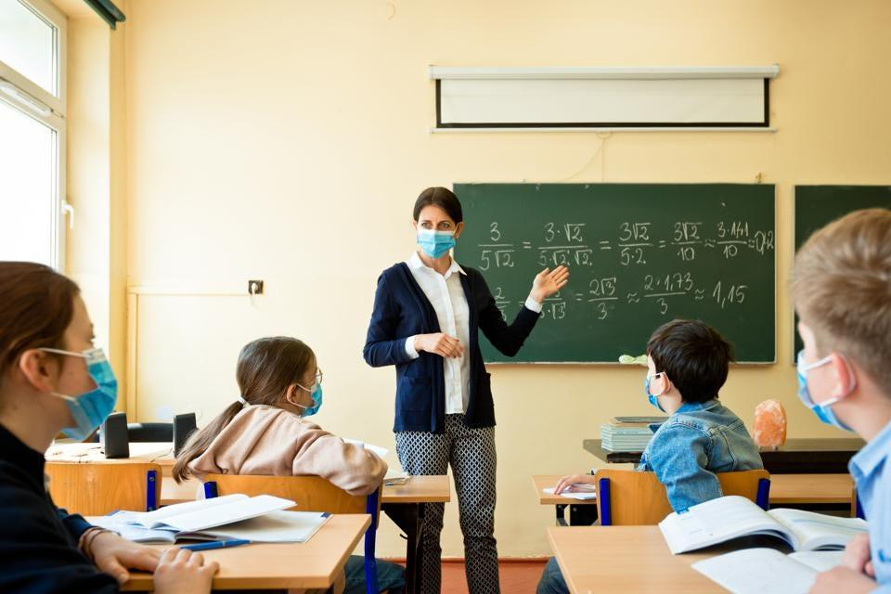
Monitoring Student Progress
Progress Reports
Grades PreK-3
Three times per year (Trimester)
Grades 4-8
Four Marking Periods
Parent Portal / Student Portal
Report Cards
Grades PreK-3
Three times per year (Trimester)
Grades 4-8
Four Marking Periods
Realtime / Realtime Mobile App

Slide 7
Attendance Policy
If a student misses homeroom, they will be marked absent for the day - an auto-generated phone call / email will be sent directly to the child’s contact regardless if you notify the teacher/secretary.
Written notification will be sent on the 4th, 8th, and 10th day

Slide 8
Retention Information - 5410
Grade 2 & Grade 3
Any student with a final failing grade in either Literacy Development or Math will be retained at grade level.
Grade K & Grade 1
If a student scores Needs Support on more than 40% of the grade level standards in Literacy Development & Mathematics, the student will be retained. *Please note Kindergarten students will be retained based upon mutual agreement between parent/guardian & school administration.
Grade 4 - Grade 8
Any student with a final failing grade in Math will be retained at grade level. Any student with a final failing grade in two major subjects (ELA, Math, Science, Social Studies) will be retained at grade level.

Slide 9
Early Release
In the event that your child needs to leave early, you must e-mail or send in a note to your child’s teacher. This information must be in writing from the parent.
In the event that your child is sick, and sent home by the School Nurse, the Nurse will contact you directly.
Please make sure that all authorized pick up contacts are listed with the school. The authorized pick up contact will need a Photo ID in order for your child to be released to them.
A child will not be released during lunch, please make every effort to pick up your child prior to, or after lunch.

Slide 10
Standards Based Report Cards
Benefits of Standard Based Report Cards
Highlights the most important skills students should learn in each subject at a particular grade level
Communicates academic progress more clearly with parents
Increases consistency among teachers and grade levels

Slide 11
Gifted and Talented
NJDOE Definition of Giftedness
Those students who possess or demonstrate high levels of ability, in one or more content areas, when compared to their chronological peers in the local district and who require modification of their educational program if they are to achieve in accordance with their capabilities. *Definition adopted by Bayonne BOE
Above Average Ability
Task
Commitment
Creativity

Slide 12
Above Average Ability
Recalls facts easily
Is very well informed about one or more topics
Shows keen insight into cause-effect relationships
Has an exceptional ability to solve problems
Exhibits extended attention span in a particular content area
Displays a passion for a topic of interest
Manages to change a topic under discussion to the discipline of his/her interest
Creativity
Possesses strong visual thinking or imaginative skills
Transfers ideas and solutions to unique situations
Prefers variety and novelty and an individual way of solving problems
Asks many and unusual questions
Often has several projects going at once
Resists external controls, tests, and challenges limits
Task Commitment
Relates to and motivates other people
Organizes others for activities
Demonstrates high levels of self-assurance when making decisions or convincing peers
Sees problems from many perspectives
Listens to and respects the opinions of others (or listens to and debates the opinions of others)
Initiates projects and extensions of assignments
Is beyond the group
Makes independent contact with or carries on a correspondence with experts in the field
Puts extensive efforts into a project - time is of no consequence

Slide 13
Strengthening Gifted and Talented
Education Act (2020)
On January 13, 2020, Governor Phil Murphy signed into law A4710, the Strengthening Gifted and Talented Education Act. The Act establishes school district responsibilities in educating gifted and talented students and requires that a coordinator for gifted and talented services be appointed at the state level. (Pandemic)
Ongoing K-12 identification process to identify intellectual ability, creativity, or in a specific academic are to include ELL, and students with IEPs and 504 plans.
Implement a research-based Schoolwide Gifted & Talented Enrichment Model in all schools.
Incorporate the fine and performing arts, technology, and media centers.

Slide 14
Notes from the Nurse
Immunizations and routine physicals are still required as per the State of NJ
Pre-K students are required to have the flu shot by Dec 31;
Kindergarten and Grade 6 requirements information to follow;
Any child who is not up to date will be excluded.
Please email updated medical information to the nurse, aconway@bboed.org
Medications in school upon our return:
Students requiring medications in school such as inhalers or epipens need paperwork for such medications. Forms can be found on BBOED website and can be returned to the nurse at any time.
Updated and correct contact information is very important, please make sure we have any change of numbers or email.
Any medical questions or concerns please email the school nurse
Have your child bring water to stay hydrated daily.

Slide 15
Social and Emotional Learning (SEL)
Social Emotional Learning activities/lessons will take place this year.
Homeroom teachers will conduct each lesson.
SAC - Daniella Barquet - dbarquet@bboed.org
Project Support Counselor - Anna Brahm - abrahm@bboed.org
If your child needs any type of counseling or support please reach out to any of our counselors.

Slide 16
Technology
Mr. Szleszynski
dszleszynski@bboed.org
Devices - All students have district issued devices
Chromebooks and Chrome Tablets are to be used only for classroom instruction, assignments, and other school related activities.
Inappropriate online activity will result in removal of device and additional services.
All devices are monitored by the district and GoGuardian
Please note that if a device is lost or considered damaged or a part/item is damaged/missing, the following fee must be paid before a new device or item is replaced:
Damaged/Lost Chromebook or Chrome Tablet - $50.00
Damaged/Lost Chromebook or Chrome Tablet Charger - $20.00
Damaged/Lost Chrome Stylus Pen - $13.00

Slide 17
Online Connections
Digital Backpack, District Homepage, School Homepage, SeeSaw or Schoology
Schoology Page:
https://bboed.schoology.com/school/2570427755
WWW.BBOED.ORG

Slide 18
Thank you for your continued support!

